Slide 1

Customer Churn Prediction
Vinit P. Borse
© All rights reserved by Fireblaze Technologies Pvt. Ltd.

Slide 2
Problem Statement
The Telecommunications industry regularly faces a lot of competition from various service providers, which generally provide services at very similar pricing points and services. In such a competitive stage, it is extremely essential for a telco company to analyze the rate at which their customers stop using their services to be able to understand how to better engage with those customers and understand their grievances.
For this project, I have obtained a longstanding telecom customer dataset of a telecom company which aims to predict whether its customers will churn or not.
© All rights reserved by Fireblaze Technologies Pvt. Ltd.

Slide 3
Proposed Solution
The classification goal is to derive rules and predict whether a customer will churn or not by using various machine learning algorithms and compare those algorithms with each others.
By using this models, we can increase churn prediction efficiency by identifying the main variables which results in churning, and have a more rational estimate about which customers are potential churners that we should contact first.
© All rights reserved by Fireblaze Technologies Pvt. Ltd.

Slide 4
Descriptive Analysis
This dataset is downloaded from ‘KAGGLE’, name as ‘Predict whether a customer will change telco provider’.
The data is straightforward. Each row represents a subscribing telephone customers. Each column contains customer attributes such as phone number, call minutes used during different times of day, charges incurred for services, lifetime account duration, and whether or not the customer is still a customer. The original dataset contains a total of 3333 rows with 1 dependent variable and 20 independent variables.
© All rights reserved by Fireblaze Technologies Pvt. Ltd.

Slide 5
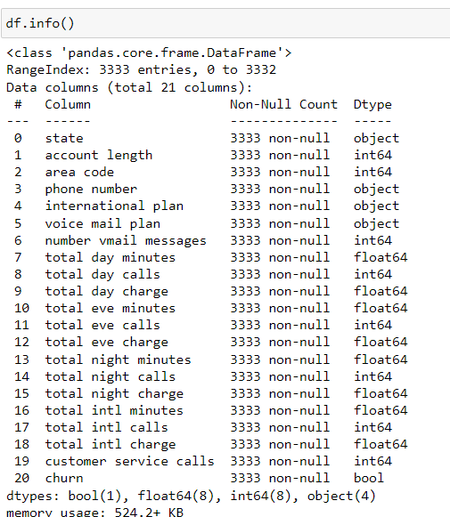

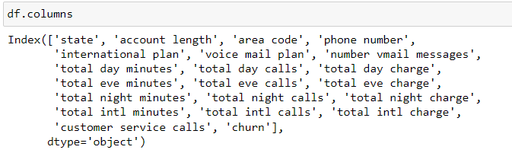
Descriptive Analysis
© All rights reserved by Fireblaze Technologies Pvt. Ltd.

Slide 6
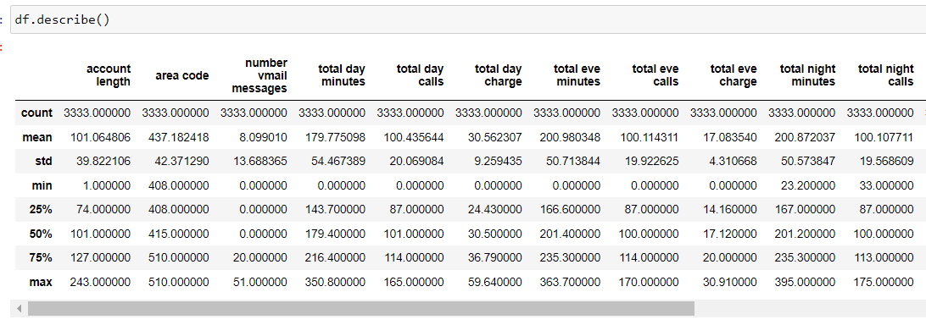
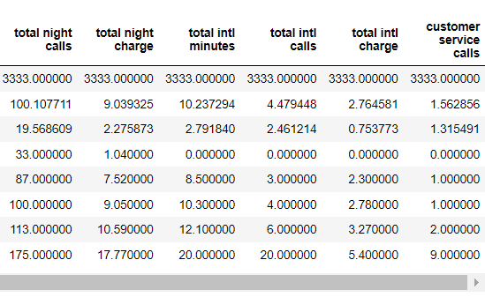
Descriptive Analysis
© All rights reserved by Fireblaze Technologies Pvt. Ltd.

Slide 7
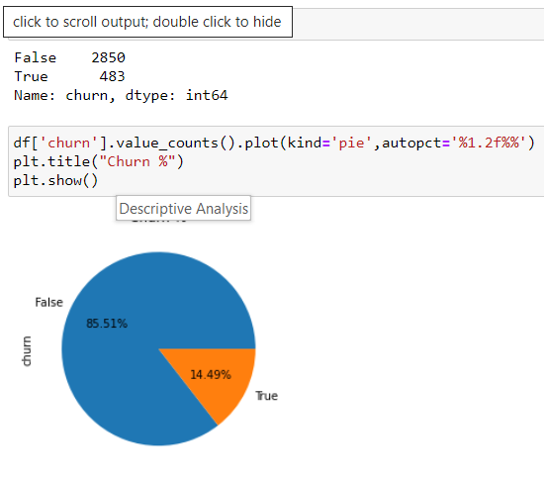
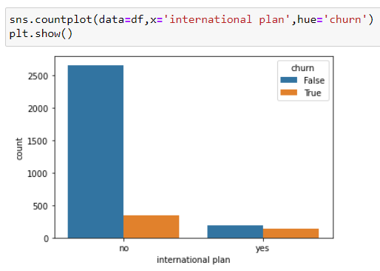
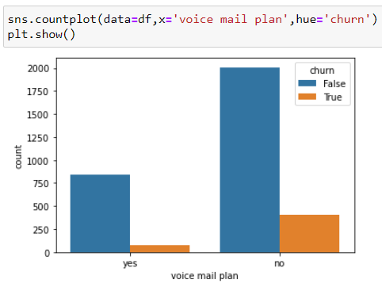
Descriptive Analysis
© All rights reserved by Fireblaze Technologies Pvt. Ltd.

Slide 8
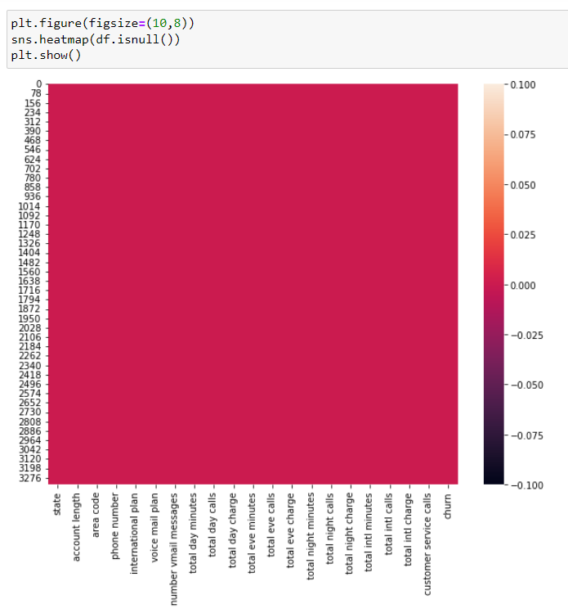
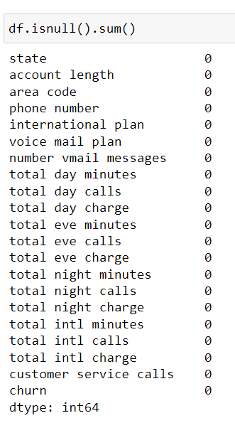
Effect of Data Preprocessing
Data cleaning =
there is no missing in dataset
© All rights reserved by Fireblaze Technologies Pvt. Ltd.

Slide 9
Effect of Data Preprocessing
Attributes Selection:
Attributes state were dropped from the model as we do not need this columns for churn prediction.
Attributes total day chargers, total evening charge ,total night charge ,total international charge were also dropped from the model as high correlation was fount between them and total day minutes, total evening minutes, total night minutes, total international minutes respectively.
© All rights reserved by Fireblaze Technologies Pvt. Ltd.

Slide 10
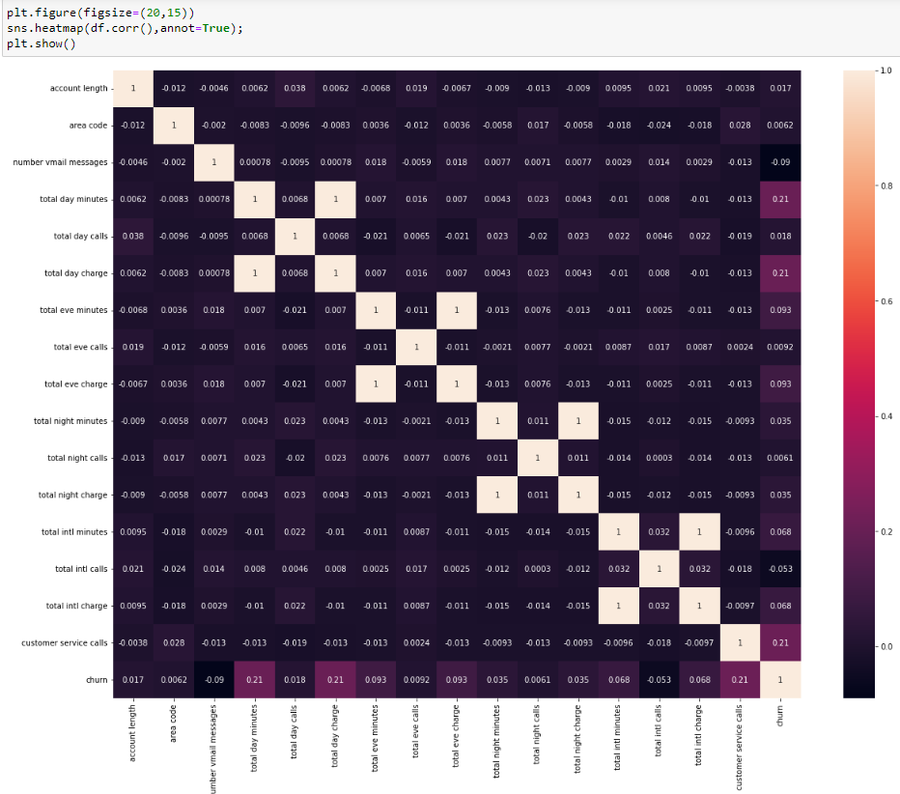
Effect of Data Preprocessing
© All rights reserved by Fireblaze Technologies Pvt. Ltd.

Slide 11
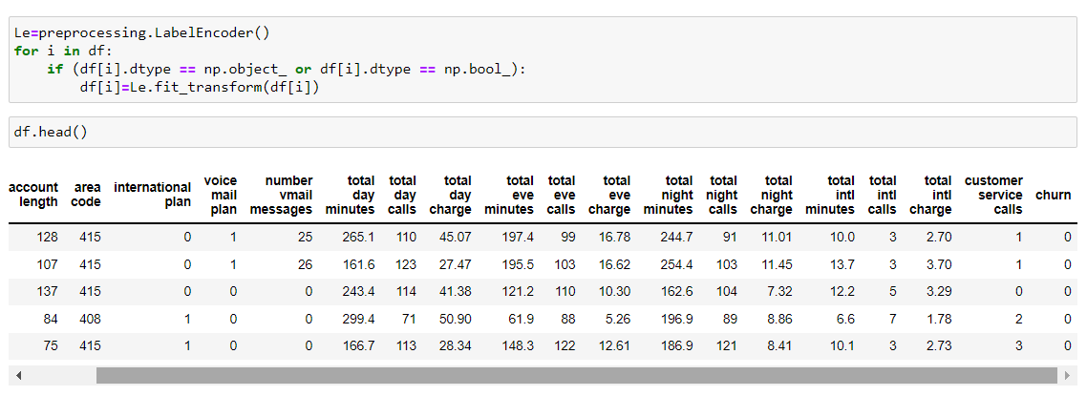
Effect of Data Preprocessing
Dealing With Categorical Data
Label Encoding :
After applying label encoding categorical columns converted into numeric value
Label encoding have induces a problem with uses number sequencing.
© All rights reserved by Fireblaze Technologies Pvt. Ltd.

Slide 12
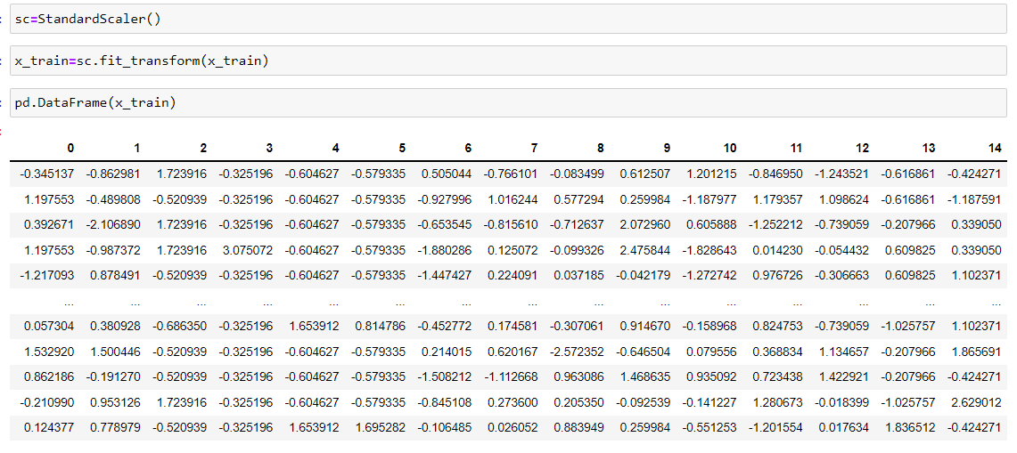
Effect of Data Preprocessing
Scale dataset :
for transformed dataset StandardScaler is used
© All rights reserved by Fireblaze Technologies Pvt. Ltd.

Slide 13
Effect of Data Preprocessing
Splitting Of Dataset
After data clean, the data ser consisting of 3333 records is divided into 2 sets.
Training Data Set : 75% of the data ( 2499 rows ) is used to develop the model.
Testing Date Set : 25% of the data ( 834 rows ) is used to evaluate the model.
© All rights reserved by Fireblaze Technologies Pvt. Ltd.

Slide 14
Machine Learning Modelling
Algorithm :
The target variable is categorical (true, false) and is not continuous, classification is the right choice.
classification :
Predicts categorical class labels and classifies data based on the training set and the values in a classifying attribute and used it in classifying new data.
Machine Learning Algorithms :
Logistic Regression.
KNeighborsClassifier.
DecisionTreeClassifier.
RandomForestClassifier.
© All rights reserved by Fireblaze Technologies Pvt. Ltd.

Slide 15
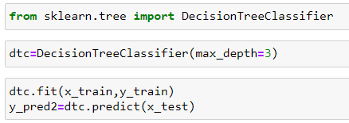
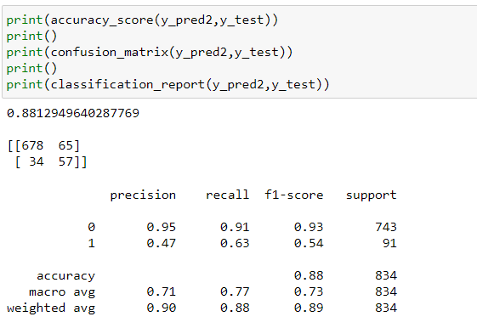
Machine Learning Modelling
DecisionTreeClassifier.
Validating the above model against our test data set, lets see what our confusion matrix and other performance parameters convey:
© All rights reserved by Fireblaze Technologies Pvt. Ltd.

Slide 16
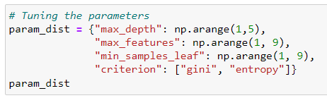

Machine Learning Modelling
Hyperparameter optimization :
A hyperparameter is a parameter whose value is used to control the learning process.
The traditional way of performing hyperparameter optimization has been grid search
© All rights reserved by Fireblaze Technologies Pvt. Ltd.

Slide 17
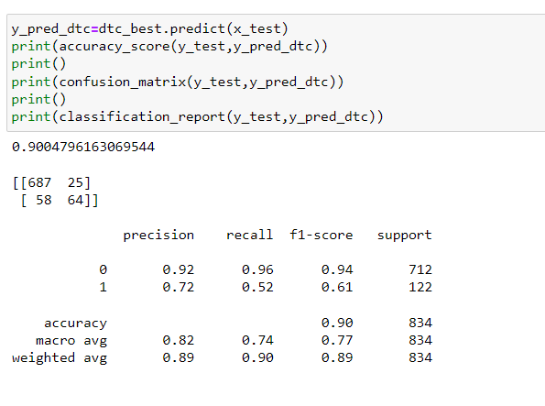
Machine Learning Modelling
Validating the above model against our test data set, lets see what our confusion matrix and other performance parameters convey:
By using GridsearchCV accuracy is increased by 2% which becomes now 90.00% accuracy.
© All rights reserved by Fireblaze Technologies Pvt. Ltd.

Slide 18
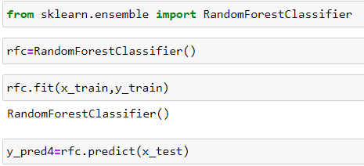
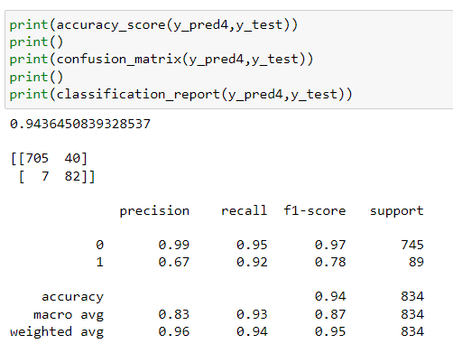
Machine Learning Modelling
RandomForestClassifier.
lets see what our confusion matrix
and other performance parameters convey.
© All rights reserved by Fireblaze Technologies Pvt. Ltd.

Slide 19
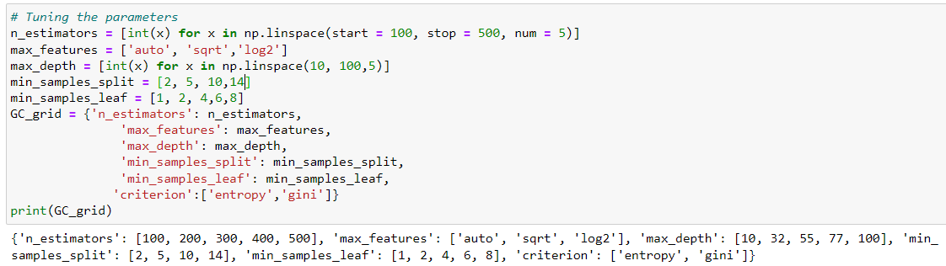
Machine Learning Modelling
Hyperparameter optimization :
The traditional way of performing hyperparameter optimization has been grid search
© All rights reserved by Fireblaze Technologies Pvt. Ltd.

Slide 20
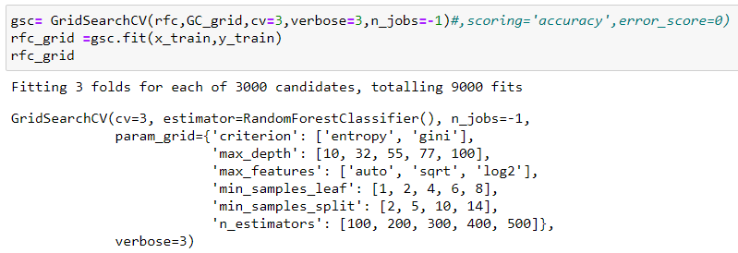
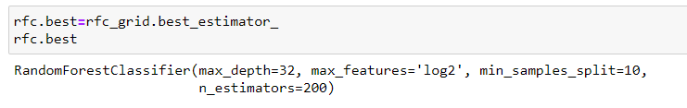
Machine Learning Modelling
© All rights reserved by Fireblaze Technologies Pvt. Ltd.

Slide 21
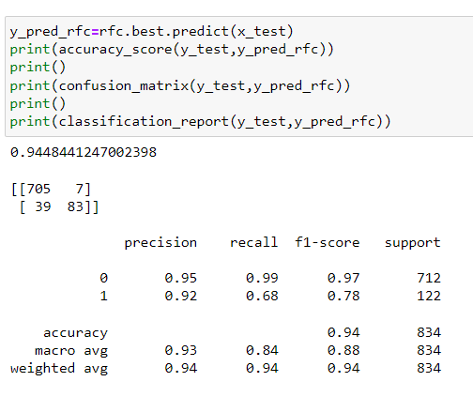
Machine Learning Modelling
Validating the above model against our test data set, lets see what our confusion matrix and other performance parameters convey:
By using GridsearchCV we got an accuracy of 94.48% in our model which is highest among the all algorithms.
© All rights reserved by Fireblaze Technologies Pvt. Ltd.

Slide 22
Conclusion
This system gives a prediction about customer churn alignment and fixing the proper threshold values, and the right combination of attributes may produce more accurate results of predicting churn customers. This system model suggests that data mining techniques gives solution for the customer churn management.
© All rights reserved by Fireblaze Technologies Pvt. Ltd.

Slide 23
Future Scope
Using this model, the telecom companies can predict in advance which customers are at rick of churn, and can target those customers and can recommended them suitable recharge plan. This system saves lots of revenues and time, which is used for replacing the already lost customers and also the ones that are already loyal customer.
© All rights reserved by Fireblaze Technologies Pvt. Ltd.

